Slide 1
Connected Intersection Message Monitoring System (CIMMS)

Slide 2
Project Goals and Objectives
Connected Intersections are generally rigorously tested when first configured but lack additional testing and verification over time.
IOOs need ways of verifying Connected Intersection behavior without undergoing costly re-evaluation procedures.
Solutions must be flexible to work with different IOO's, intersections, and environments.
Solution must operate continuously and enable rapid response to incorrect and invalid message behavior.
CIMMS is build on the ODE Open-Source code base managed by USDOT

Slide 3
Project Overview
Driver behavior is generally predictable when responding to traffic control devices​
Leverage increasing availability of Vehicle-to-Everything (V2X) data for ​
Dynamic, near-real time​
Static analysis of historical data​
Assess:​
Conflicts between vehicular movement and expected behavior (governed by SPaT and MAP)​
Conflicting information in SPaT and MAP​
Goal: Pinpoint conflicts/deviations so that they can be brought to the attention of the system owner and corrective actions may be taken

Slide 4
Connected Intersection Message Monitor
Near real time message analysis and verification
Message Structure Verification (J2735)
Message Content Verification (CTI 4501)
Validate SPaT and MAP consistency
Detect illegal or impossible MAP/ SPaT combinations
Detect misaligned MAP/ SPaT messages
Vehicle Event Detection (BSM)
Utilize Vehicle Traffic to verify intersection geometry and light timings
Store SPaT / MAP / BSM for further analysis
Create assessments for tracking long term trends and behaviors
Allows user configurable (could be standardized) settings for detecting non-compliant behavior
Generate notifications/reports for IOOs describing non-compliant events

Slide 5
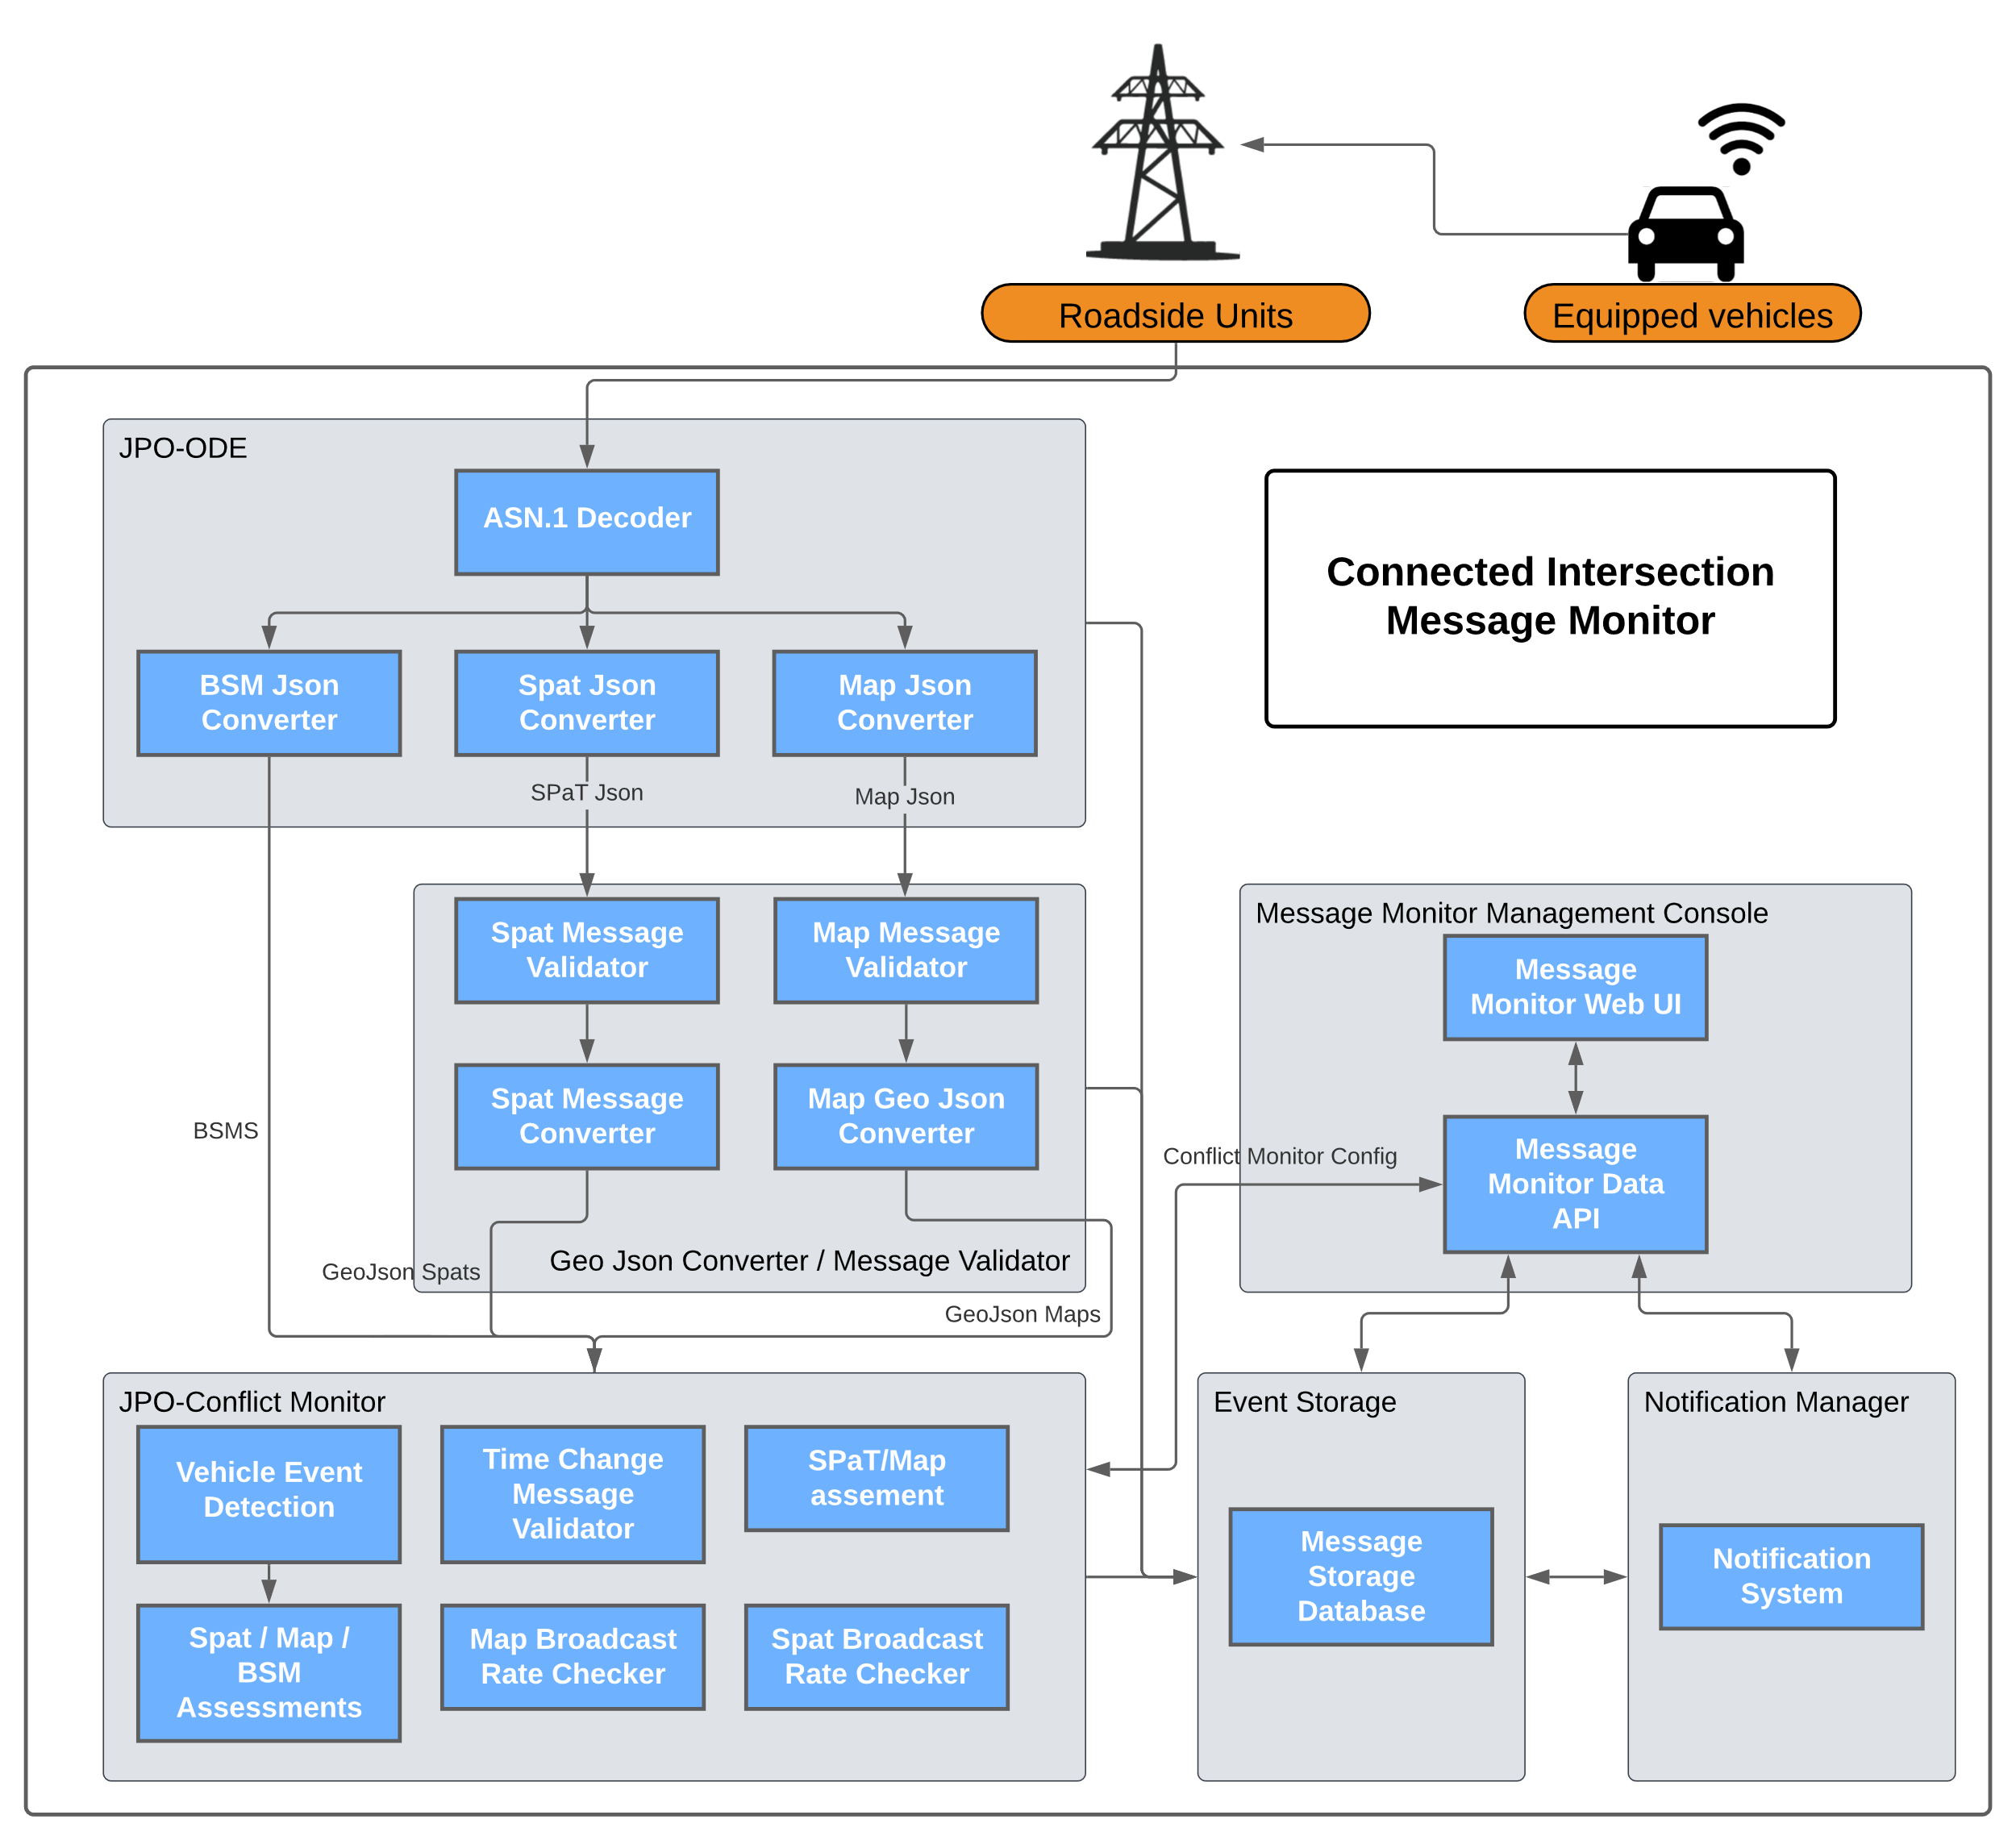
Message Monitor Data Flow
The Conflict Monitor leverages existing capabilities of the jpo-ode to streamline message ingest and processing.
Processed messages from the ODE are then passed to the GeoJSON converter for validation and conversion to viewable GeoJSON formats.
The converted messages are pulled into the JPO-Conflict Monitor. Messages are evaluated to verify over time some components of the intersection is functioning properly.
GeoJSON messages and the corresponding intersection events are then stored in a database for further analysis via the message monitor console.
Users may view captured, events, assessments and notifications via the Web Management Console.

Slide 6
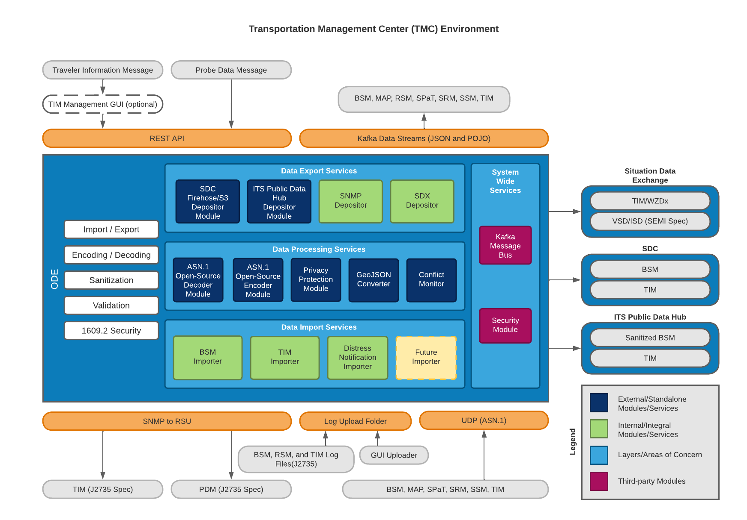
Operational Data Environment
The Intelligent Transportation Systems Joint Program Office (ITS JPO) Operational Data Environment (ODE) is a real-time virtual data router that ingests and processes operational data from various connected devices
The ODE is the backbone for the CIMMS software and performs real-time message ingest and decoding for Conflict Monitor components
The ODE is fully Dockerized enabling flexible deployment in many environments
Open-Source

Slide 7
Message Validation
The Conflict Monitor performs the following checks on intersections
Time Based Validation
SPaT broadcast rate validation - Check 10x / second
MAP broadcast rate validation - Check 1x / second
SPaT time change validation - Check that time signatures increment
Message Based Validation
Intersection Reference Alignment Checks - Check SPaT ID’s match MAP ID’s
Signal Group Alignment - Check SPaT Signal Groups match MAP Signal Groups
Signal State Conflict – Check that signal lights produce valid configurations
Vehicle Based Intersection Validation
Signal State Event Detection - verify vehicles cross during green lights
Lane Direction of Travel Detection – verify that lanes line up with vehicle paths
Lane Connection of Travel Event – verify that MAP message connections match vehicle paths
Vehicle Stop Event – verify light is red when a vehicle stops

Slide 8
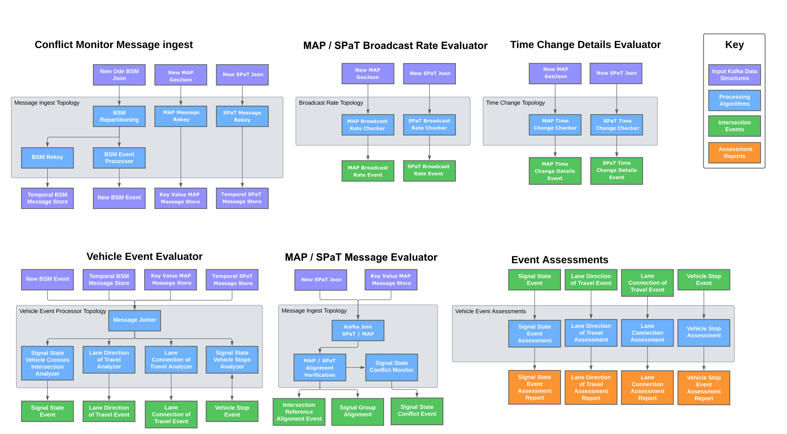
Conflict Monitor Details Diagram

Slide 9
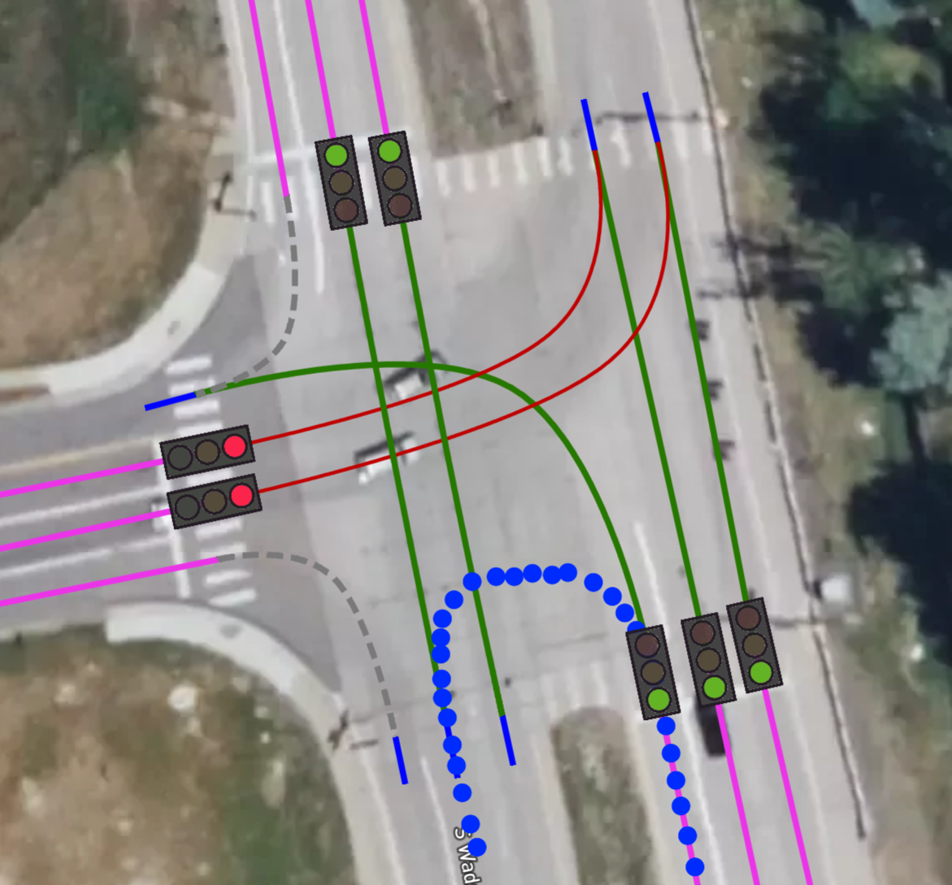
Events
Intersection Events are generating whenever the Conflict Monitor finds a single problematic instance within an intersection. For example:
The Conflict Monitor sees 20 SPaT messages for a single intersection in 1 second.
Matching SPaT and MAP messages show different signal groups for the intersection.
A SPaT message shows an illegal configuration of lights (e.g., All green)
Vehicle Events are generated whenever a vehicle passes through an intersection.
Events are generated for both compliant and non-compliant behaviors
Examples
A vehicle enters the intersection through lane 2 and exits via lane 16
A vehicle drives into an intersection without being centered in its lane
A vehicle enters the intersection while the light is red

Slide 10
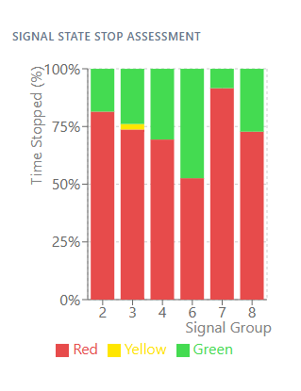
Assessments
Multiple events are aggregated into assessments.
Ensures intersection issues are generally not caused by individual drivers.
Tracks trends over time
Assessments check to see if the intersection complies based upon user configurable thresholds.
If an assessment doesn’t pass, a notification is issued.
Example:
A Lane Direction of Travel Assessment contains the median distance from centerline of vehicles driving through the lane.
If the median distance from centerline exceeds the acceptable threshold, a notification is issued.

Slide 11
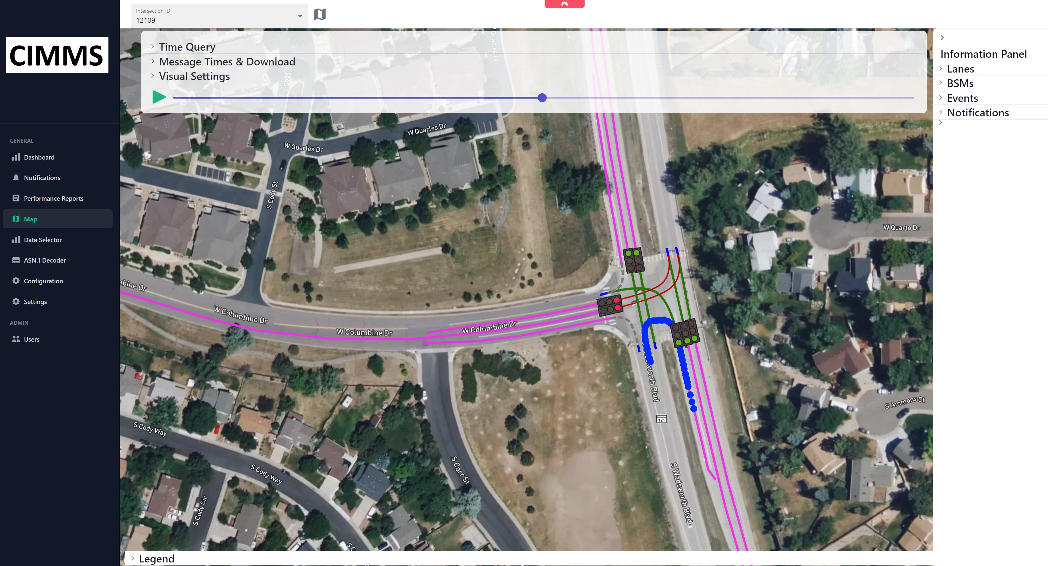
Notifications
When a non-conforming event or assessment is created a notification is issued.
Notifications can be sent via email to traffic personal to indicate urgent problems that must be corrected.
Notifications can also be reviewed in the Message Dashboard to help traffic managers debug the source of the problem.

Slide 12
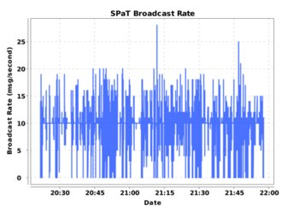
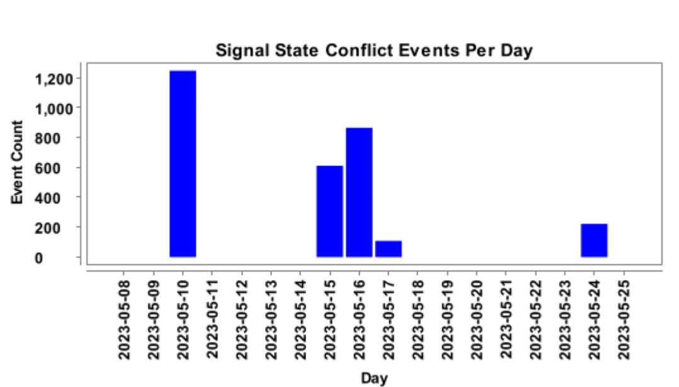
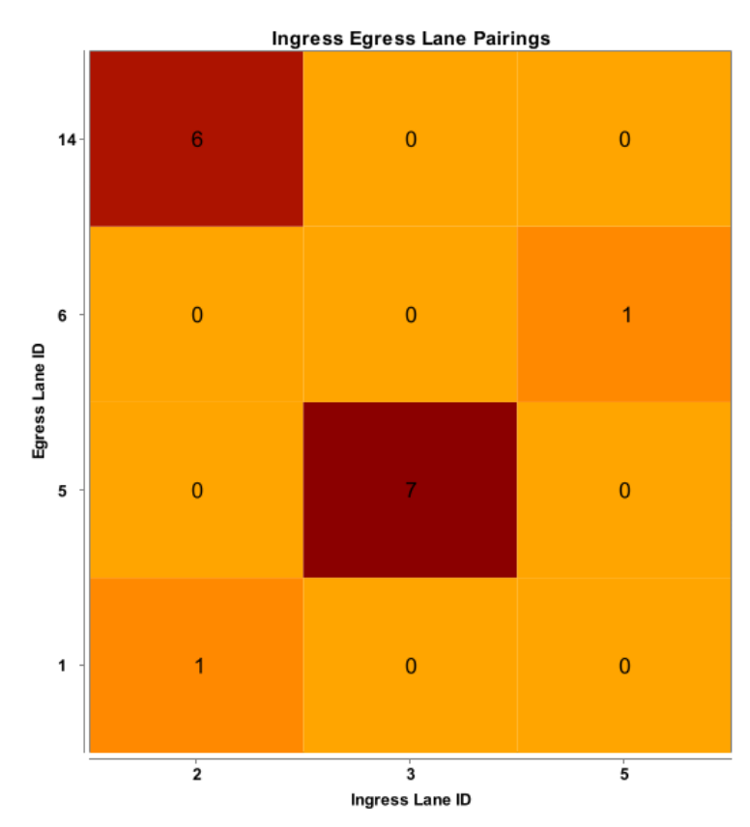
Reporting
The Conflict Monitor can generate PDF reports of intersection behavior over time.
These reports include graphical summaries of vehicle patterns and provide additional details from events and assessments.

Slide 13
Deployment and Scalability
The CIMMS System is designed to horizontally scale to handle dozens of intersections in parallel.
CIMMS is fully Dockerized and has been successfully deployed in a variety of environments
Maricopa County
On Premise Deployment
Docker Compose
6 Intersections
UDOT
AWS Deployment
Docker Compose
5 Intersections
CDOT
Google Cloud Platform
Kubernetes
27 Intersections

Slide 14
Demo

Slide 15
Questions?

